Slide 1
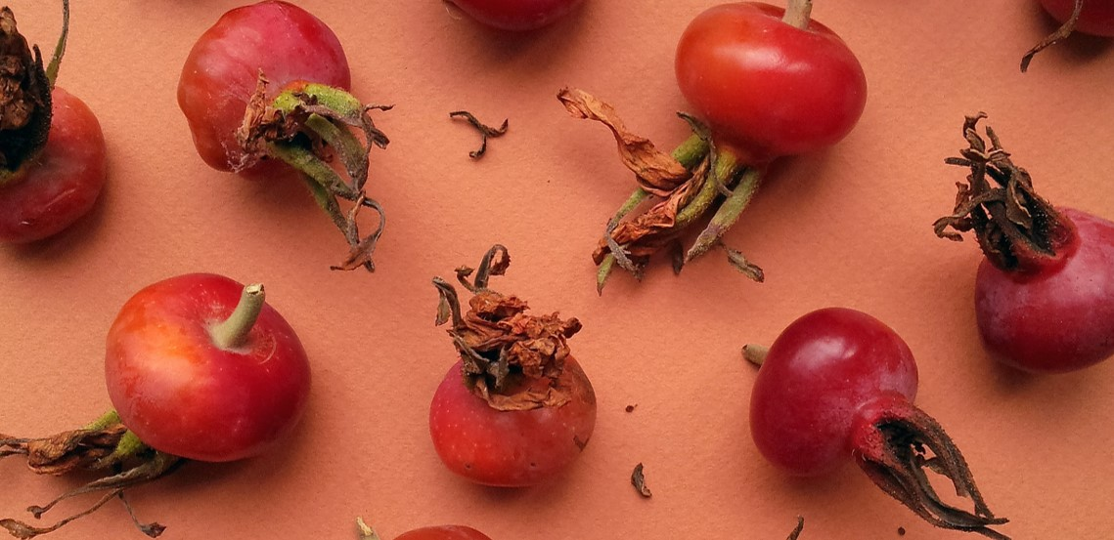
F&B Flavors in North America Region
Adarsh Balan
Research Associate, AMPBA Student at ISB
Mob. +91-7837952926
Email: adarshb3@gmail.com
Notes:
© Copyright PresentationGO.com – The free PowerPoint and Google Slides template library

Slide 2
Agenda
Industry Overview
North America Market Overview
Analyzing Data and Extracting Insights
Major Flavor Groups in the New Product Launches
Major Customer Segments and Positioning
Identifying Top 10 Emerging Flavors: The Challenges
Pareto Principle: The Final Approach
Final Visualization

Slide 3


Industry Overview
7.3 % CAGR in 2023
Global Food & Beverage Market Size: $7,221.73 Billion
At an Expected Growth Rate of 6.3% Through 2027 the market size is expected to grow to $9,225.37 Billion
Asia pacific is the largest region in the market followed by the Western Europe.
- The Business Research Company
BACKGROUND
Explore the current landscape of the global Food & Beverage market.
Understand the key factors driving market growth.
Identify emerging trends and opportunities within the industry.
Analyze challenges and potential risks.
Conclude with key takeaways and actionable insights.
According to food navigator, the sale of natural and organic food & beverages would surpass $300 billion by 2024 and $400 billion by 2030 in the U.S. market
OBJECTIVE
Notes:
© Copyright PresentationGO.com – The free PowerPoint and Google Slides template library

Slide 4
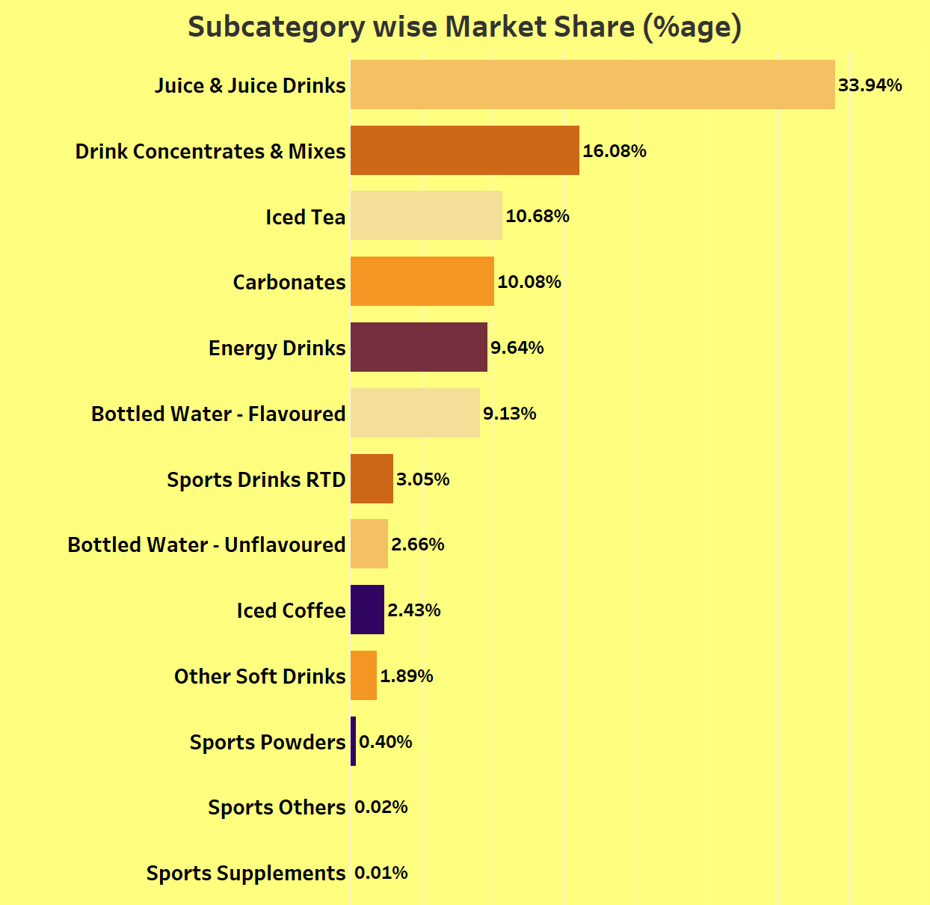
North America Market Overview
Popular Market Subcategories: The dataset includes a wide range of market subcategories. The most popular subcategories, based on the highest counts, are "Juice & Juice Drinks," "Drink Concentrates & Mixes," and "Iced Tea." These subcategories have the highest presence in the market.
Variety of Choices: Consumers have a diverse range of choices when it comes to beverages in North America. There are numerous subcategories, indicating a variety of beverage options available in the market.
Preference for Non-Alcoholic Options: The majority of subcategories appear to be non-alcoholic, with options like "Carbonates," "Energy Drinks," and "Bottled Water - Flavored" ranking high in terms of counts. This suggests a preference for non-alcoholic beverages among consumers.
Limited Availability: On the other hand, subcategories like "Sports Powders," "Sports Others," and "Sports Supplements" have relatively lower counts. This might indicate limited popularity or availability of these products in the North American market.
Health-Conscious Choices: The presence of subcategories like "Iced Tea" and "Iced Coffee" suggests a preference for refreshing and potentially healthier beverage options, possibly driven by health-conscious consumers.
Market Segmentation: The diversity in market subcategories reflects market segmentation, catering to various consumer preferences and needs. This segmentation allows businesses to target specific customer segments effectively.

Slide 5
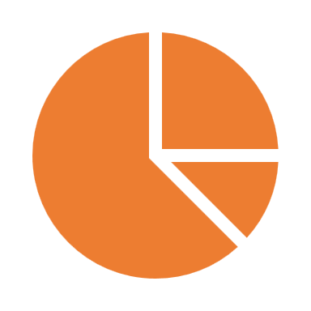


Analyzing Data and Extracting Insights
Market Segmentation
Major Flavor Groups
Top Positioning Customers
Top 10 Emerging Flavors
Consumer Trends and Preferences

Slide 6
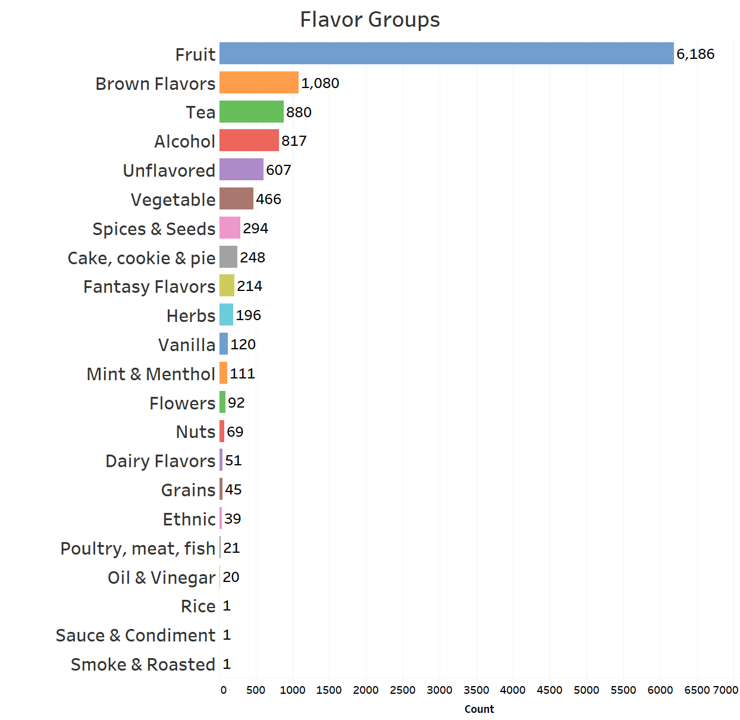
Major Flavor Groups in the New Product Launches
Understanding flavor groups is pivotal in the beverage industry as it enables precise product development, targeted marketing, and aligning offerings with evolving consumer preferences.
Fruit Dominance: "Fruit" emerges as the dominant flavor group, with the highest count, indicating its widespread popularity among consumers.
Diverse Taste Profiles: The presence of flavor groups such as "Tea," "Alcohol," and "Vanilla" signifies the diverse taste preferences catered to by the industry.
Health and Wellness: "Unflavored" and "Vegetable" flavor groups suggest a growing interest in health and wellness, with consumers seeking more natural and vegetable-based options.
Indulgence and Comfort: "Cake, cookie & pie" and "Fantasy Flavors" demonstrate consumers' affinity for indulgent and comfort-driven beverage experiences.
Cultural Diversity: The "Ethnic" flavor group highlights the influence of cultural diversity on beverage flavor trends.
Niche and Unique: Flavor groups like "Smoke & Roasted," "Sauce & Condiment," and "Rice" are relatively niche and indicate room for innovation and unique product offerings.

Slide 7
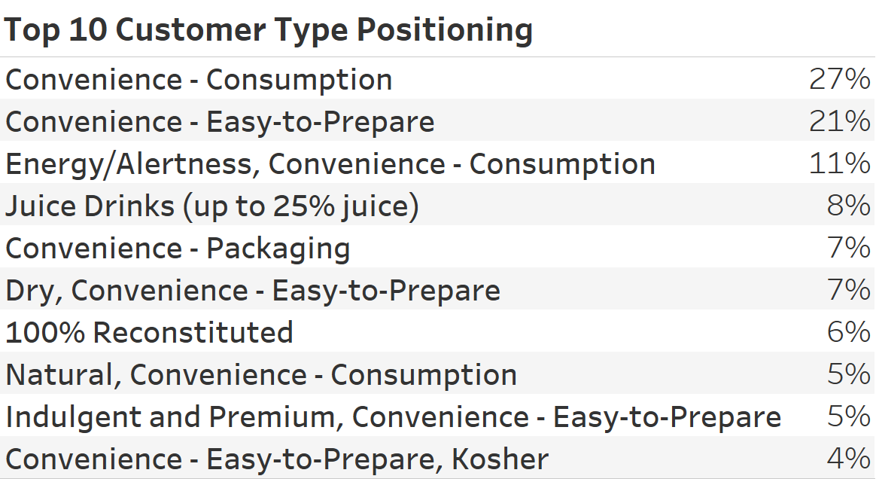
Major Customer Segments and Positioning
One prevalent strategy, "Convenience - Consumption," emerges as a dominant theme. This suggests that a significant portion of beverage products is marketed with a strong emphasis on ease of consumption. The appeal of convenience aligns with the fast-paced lifestyles of today's consumers, who seek practical and effortless options.
The hybrid strategy of "Energy/Alertness, Convenience - Consumption" combines the benefits of energy enhancement with convenience. This positioning caters to consumers looking for both a convenient beverage solution and the added perk of increased alertness and energy.
Closely following is the positioning strategy of "Convenience - Easy-to-Prepare." This positioning highlights the significance of products that not only offer convenience in consumption but also in preparation. It underscores the idea that quick and uncomplicated preparation is a substantial selling point for beverages.
Further analysis reveals a focus on juice content with "Juice Drinks (up to 25% juice)." This positioning emphasizes the percentage of juice contained in the product, potentially targeting health-conscious consumers seeking a balance between flavor and nutrition.

Slide 8

Identifying Top 10 Emerging Flavors: The Challenges
Data Preprocessing and Flavor Grouping: I began with data preprocessing tasks, ensuring quality and consistency. This involved handling missing values and converting launch dates into a uniform format. Most notably, we embarked on flavor standardization, a crucial step. Initially, we used the "fuzzywuzzy" library to efficiently map similar flavors. However, this process, while effective, took considerable time—approximately 51 minutes.
Efficiency with the Jaccard Principle (TF-IDF): Recognizing the need for efficiency, we transitioned to the Jaccard Principle using TF-IDF (Term Frequency-Inverse Document Frequency) for Flavor Group mapping. This method proved exceptionally efficient, taking a mere 0.4 seconds to identify the best flavor matches. This improved approach streamlined our analysis significantly.
Identifying Emerging Flavors: With our standardized flavor data, we turned our attention to identifying Emerging Flavors. These were defined as those showing significant growth over the last five years. By analyzing flavor frequency and launch dates, we pinpointed flavors that had gained substantial traction in recent times.

Slide 9
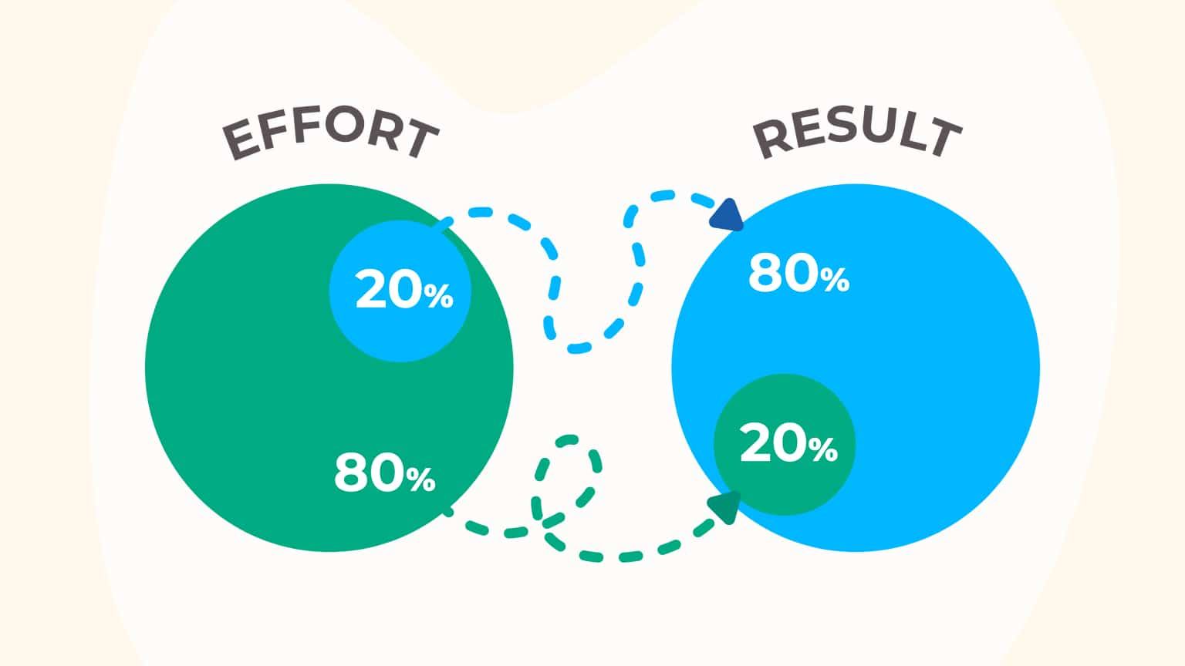

Pareto Principle: The Final Approach
When confronted with the task of uncovering the Top 10 Emerging Flavors in the North American beverage market, we opted for a strategic approach. Our goal was to pinpoint flavors that weren't merely popular but had a distinct upward trajectory over the past five years.
Yearly Trend vs. Total Counts
Instead of relying solely on the total highest counts from the dataset, we recognized the importance of capturing the essence of "emerging" flavors. To do this, we adopted a yearly trend or growth rate approach. This method offered a nuanced perspective by focusing on flavors that had demonstrated consistent and significant growth over time.
Applying the Pareto Principle
The Pareto Principle, often referred to as the 80/20 rule, states that roughly 80% of effects come from 20% of causes. In our case, this principle proved invaluable. By targeting the top 20% of flavors with the highest counts, we could ensure our analysis prioritized flavors that held the most substantial market presence.
The Significance of the Top 12
Our data revealed a striking insight. By selecting the top 12 flavors in the Pareto distribution, we effectively captured the essence of the market. These flavors represented the top 20% and accounted for a significant portion of the total flavor landscape. This strategic choice ensured that our analysis was focused on the most impactful flavors that truly resonated with consumers.
Unlocking Strategic Insights
This approach allowed us to unlock strategic insights into the North American beverage market. By concentrating on flavors with consistent growth and significant market share, we provided businesses with actionable intelligence. These top 12 flavors are not only the most popular but also the most promising for future market trends.

Slide 10
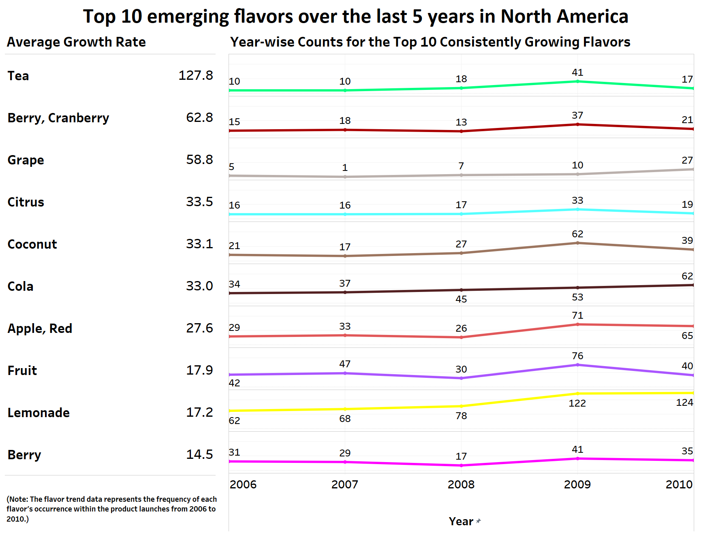
Final Visualization
In my analysis of flavor growth rates, several key insights emerged. Tea stands out as the star performer with an astonishing growth rate of 127.78%, showcasing its explosive popularity. Berry, Cranberry and Grape flavors follow closely, indicating consistent consumer appeal. Classic flavors like Cola and Citrus maintain strong growth, emphasizing their timeless charm. Apple, Red flavor exhibits impressive growth, while Lemonade and Fruit maintain steady popularity. These findings reflect the dynamic nature of consumer preferences, offering valuable insights for product development and market strategies

Slide 11
Thank You!
Notes:
© Copyright PresentationGO.com – The free PowerPoint and Google Slides template library

